Slide 1

EXAMINING THE IMPACT OF HEALTH INDICATORS, SOCIOECONOMIC FACTORS, AND EDUCATION ON GLOBAL LIFE EXPECTANCY.
SAIKUMARREDDY YALAGALAPALLI

Slide 2


INTRODUCTION
Influence of Socioeconomic Status (SES): Lower SES is linked to reduced life expectancy due to higher mortality rates, regardless of age and sex.
Educational and Occupational Disparities: Significant disparities in life expectancy are associated with levels of education and type of occupation, with lower education and manual occupations linked to shorter life spans (Singh & Lee, 2020).
Economic Development: Higher GDP per capita is associated with increased life expectancy, as economic growth provides resources for better nutrition, healthcare, and living conditions (Freeman et al., 2020; Rogoz et al., 2022).

Slide 3

RESEARCH QUESTION &HYPOTHESIS
Research Question1: What are the primary health indicators and
socio-economic factors that significantly influence life expectancy across different countries?
Null Hypothesis (H0): The health indicators and socio-economic
factors (such as adult mortality, infant deaths, health expenditure,
Hepatitis B coverage, under-five deaths, Diphtheria immunization
coverage, HIV/AIDS prevalence, income composition of
resources, thinness in children aged 5-9 years) do not have a significant impact on life expectancy.
Alternative Hypothesis (Ha): At least one of the health
indicators and socio-economic factors has a significant impact on life expectancy.
Research Question2: How does the level of education impact life
expectancy when controlling for economic status and health indicators?
Null Hypothesis (H0): The level of education, as represented by
the "Schooling" variable, does not have a significant impact on
life expectancy after accounting for economic status and health indicators.
Alternative Hypothesis (Ha): The level of education has a
significant impact on life expectancy, even after controlling for
economic status and health indicators

Slide 4


DATA SET
Our project uncovers the determinants of life expectancy by analyzing global health data from 2000-2015. Through rigorous data analysis using R, we aim to understand how factors such as health indicators, economic status, and education levels impact life expectancy.
The dataset spans from 2000 to 2015, covering 193 countries, and includes variables related to life expectancy and various health factors obtained from the WHO Global Health Observatory data repository.
Economic data was sourced from the United Nations website. This comprehensive dataset allows for a detailed analysis of trends and factors influencing life expectancy over a significant period.
Data collected from Kaggle .The final dataset used for modelling comprises 2938 rows and 22 columns, with 20 predictor variables categorized into immunization, mortality, economic, and social factors.
Link: https://www.kaggle.com/datasets/kumarajarshi/life- expectancy-who

Slide 5
STEPS
Data Collection
Data Cleaning
Exploratory Data Analysis Normality Testing
Data Visualization Statistical Modeling
Model Refinement and Diagnostics

Slide 6
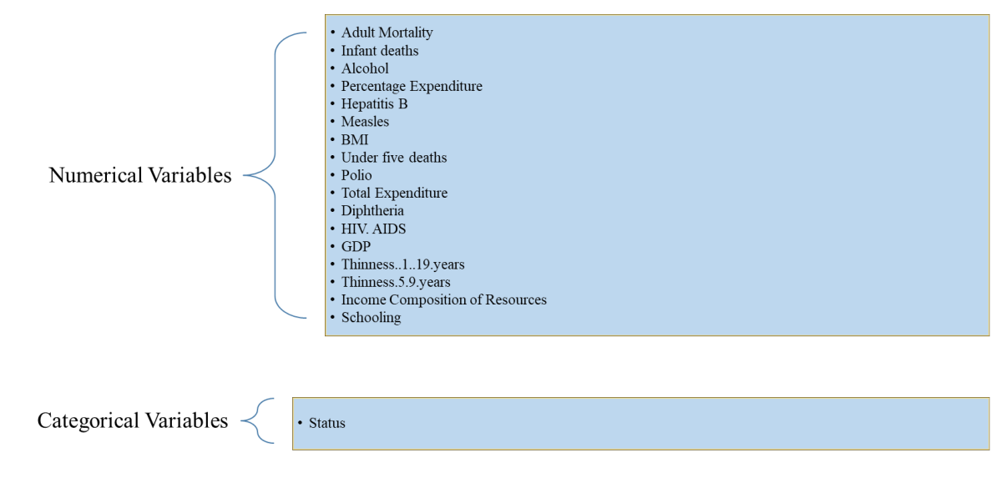
Analyzing Data Variables

Slide 7

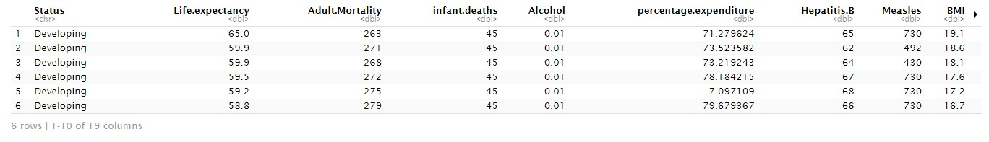


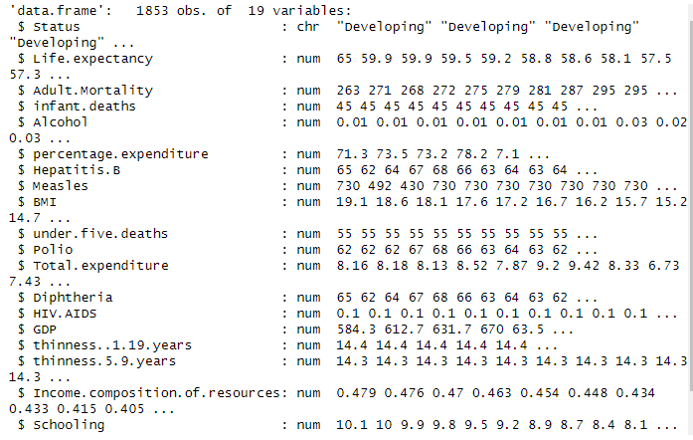

Data Importing & Data Description
The CSV file containing Life Expectancy data was uploaded to R using the "read.csv" code.
We examined the first few rows of the modified dataset with the command "head(data)" and obtained a string type of the columns
dataset using “str(data).”

Slide 8
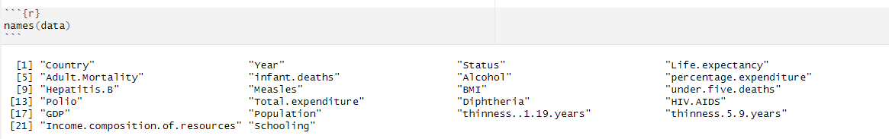
Defining the selected variables
We removed extra spaces in column names and later we selected relevant variables from a dataset by excluding the columns “Country”, “Year”, and “Population”.

Slide 9
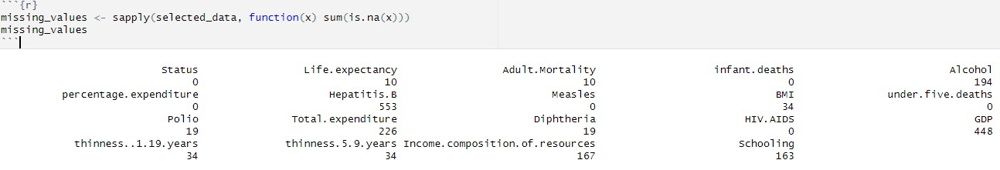
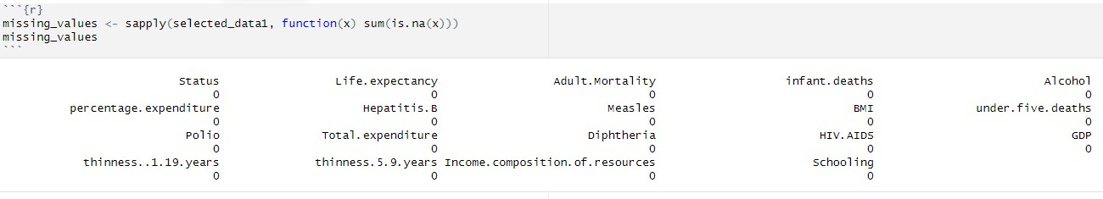
Data Cleaning
We calculated the number of missing values in each column of the “selected_data” the NA values in each column and stores the result in the “missing_values” object.
by applying a function that sums up
We removed rows with missing values from the “selected_data”, stored the result in “selected_data1”, and then verified
the removal by calculating and displaying the number of missing values in each column of the “selected_data1”.

Slide 10
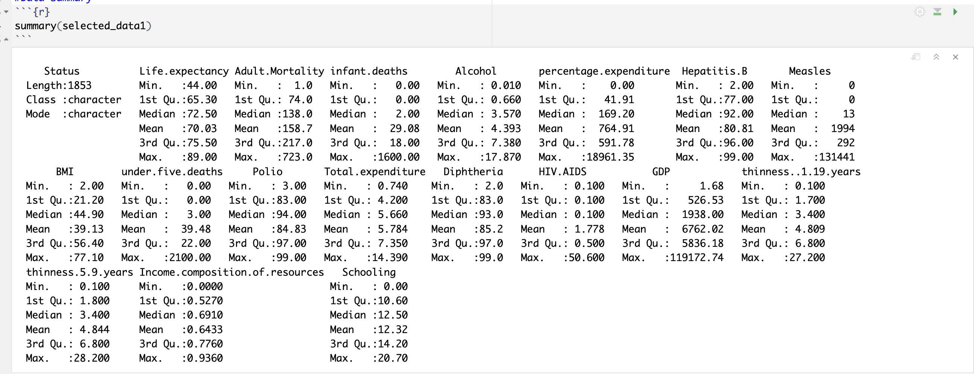
Exploratory Data Analysis
Summary Statistics:
We generated a summary of the “selected_data1”, providing key statistical measures such as mean, median, minimum, maximum, and quartiles for each variable in the dataset. This exploration provided a detailed insight into the central tendencies and distribution characteristics of the dataset.

Slide 11


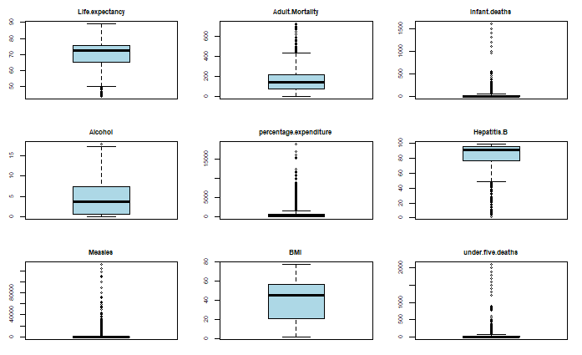
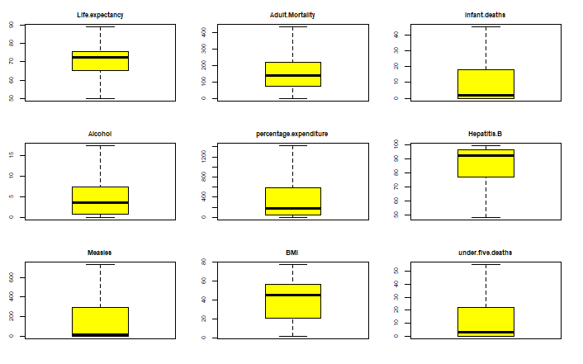
Outliers Detection
We generated boxplots for each numeric column in the “selected_data1”. to visualize outliers and then defined a function to cap outliers at 1.5 times the interquartile range below the first quartile and above the third quartile and apply this function to each numeric column in the “selected_data1”, and finally checked the number of outliers in each numeric column after the capping process.

Slide 12
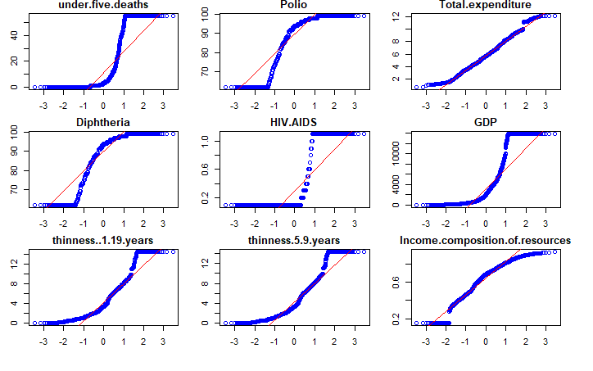
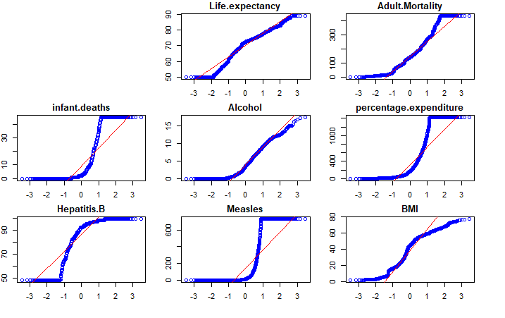
Checking for Normality
•.
The code generates Quantile-Quantile (Q-Q) plots for each numeric column in the “selected_data1”. dataset to assess if the data in these columns follows a normal distribution, with the plots organized in batches of up to nine per page for easy visualization

Slide 13
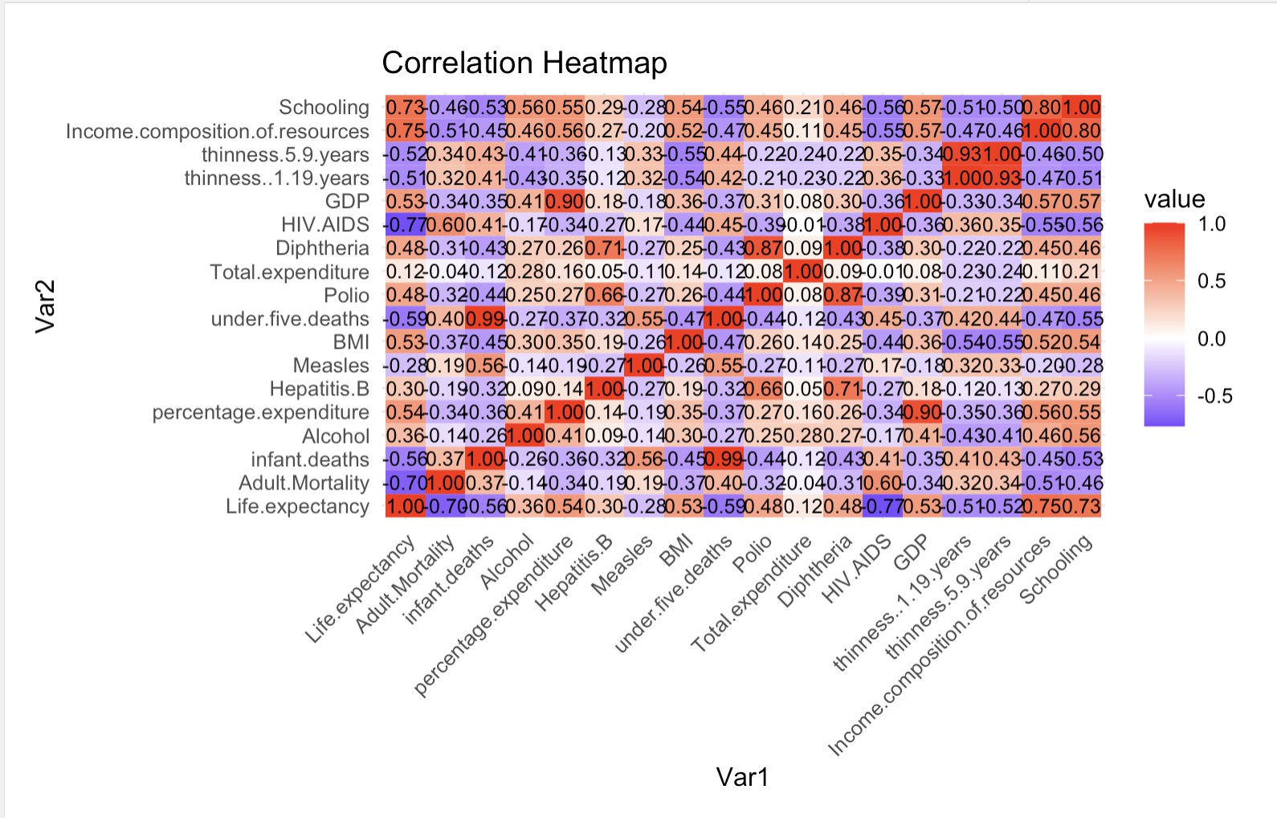
Correlation Heatmap
We calculated the correlation matrix for the numeric columns for the data, reshaped this matrix into a format suitable for visualization, and then created a heatmap to visualize the correlations, with correlation coefficients displayed on the heatmap.

Slide 14


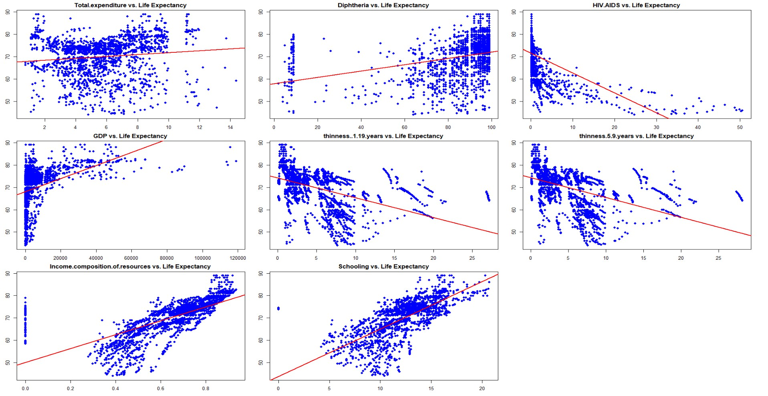
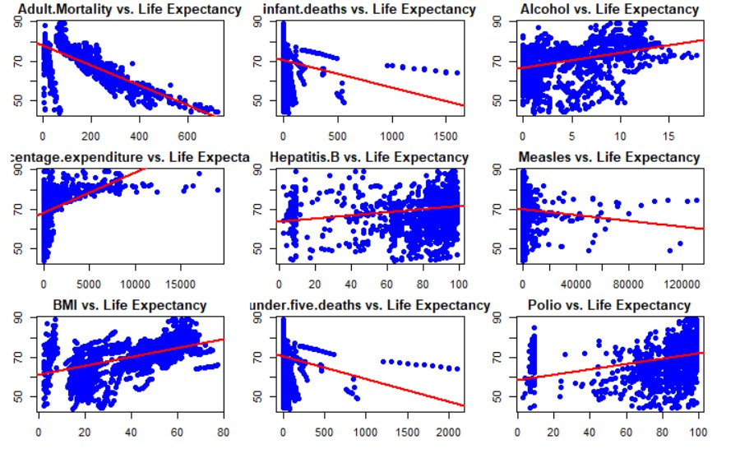
Statistical Modelling
We generated scatter plots for each numeric column (excluding “Life. expectancy”) in the dataset against “Life.expectancy”,
fit a linear regression line to each plot, and organize the plots for easy visualization.

Slide 15
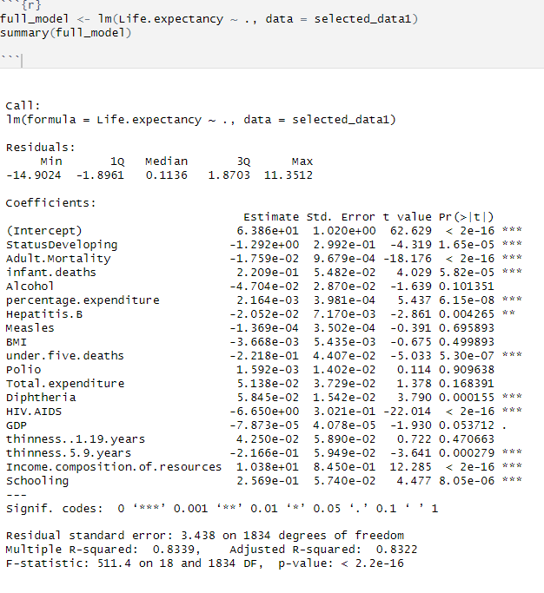
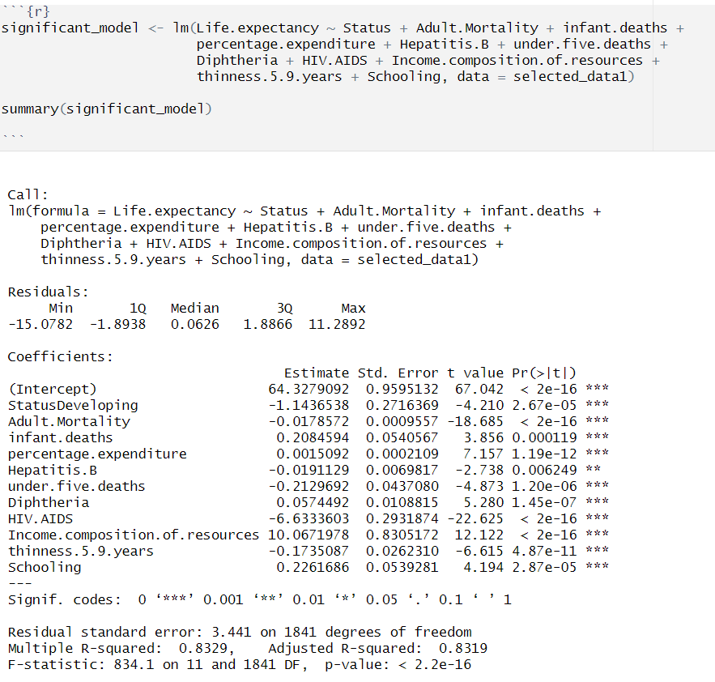
Multiple Linear Regression Model
We conducted a multiple linear regression model to visualize the data in a linear distribution. The findings highlight the variables that significantly impact life expectancy, such as developing status, adult mortality, under-five deaths, increased BMI, and vaccination coverage. The HIV/AIDS rate is a major concern that dramatically decreases life expectancy. Additionally, higher levels of human development, education, and income composition of resources show strong positive associations, indicating the importance of targeted health interventions, improved education, and resource allocation for enhancing life expectancy in various countries.
Model Refinement
Building Linear regression model with only significant predictors

Slide 16
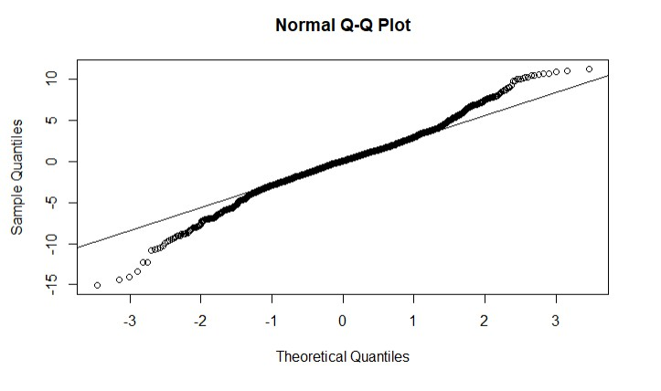
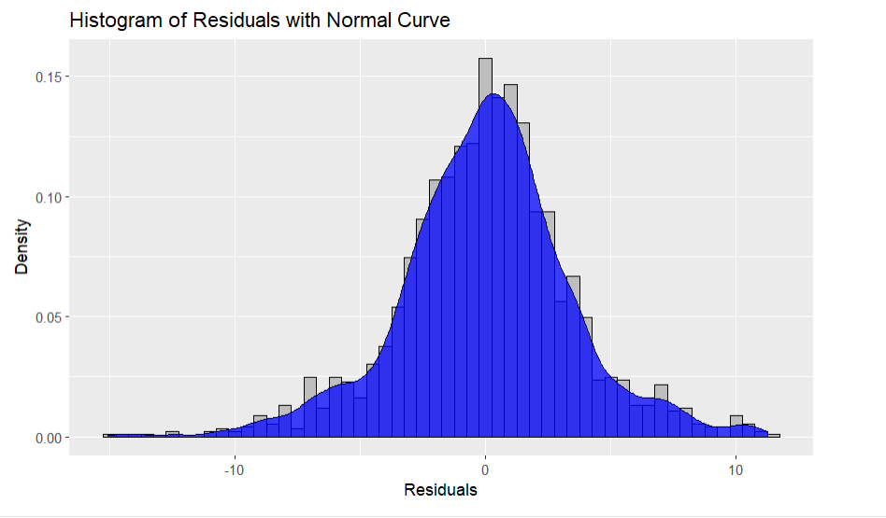
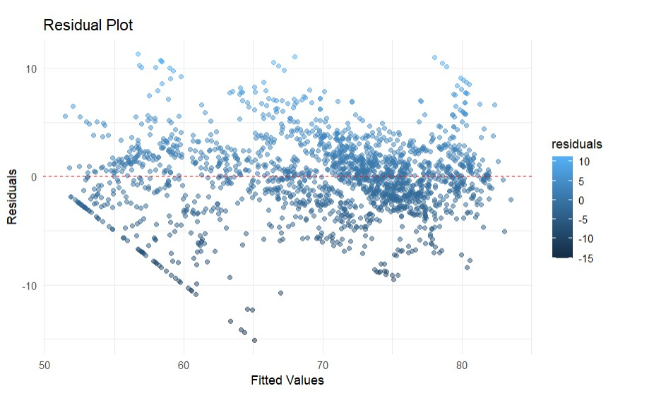
Model Diagnostics
We generated a Quantile-Quantile (Q-Q) plot of the residuals from the “significant_model” to assess if the residuals follow a
normal distribution, which is an important assumption in linear regression models.
The code creates a histogram and a density plot of the residuals from the “significant_model” to visualize their distribution, which
helps in assessing the goodness of fit of the model.

Slide 17
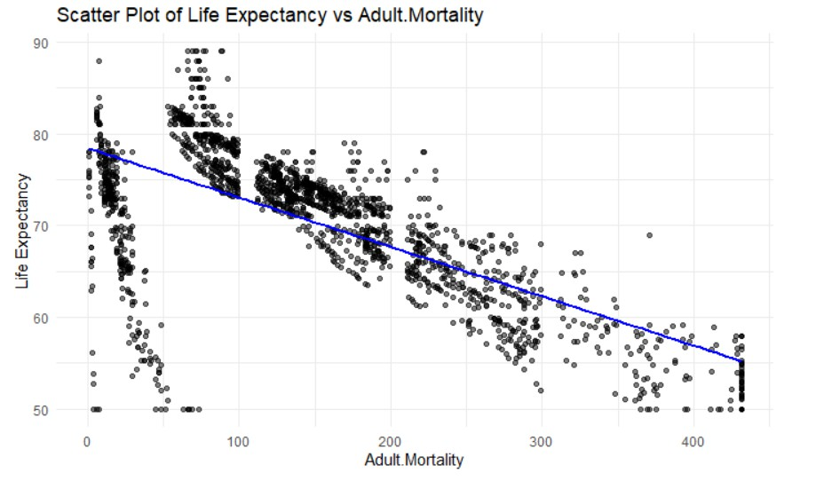
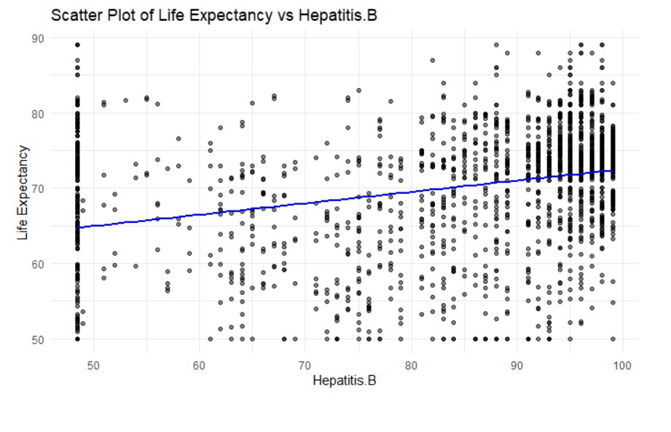
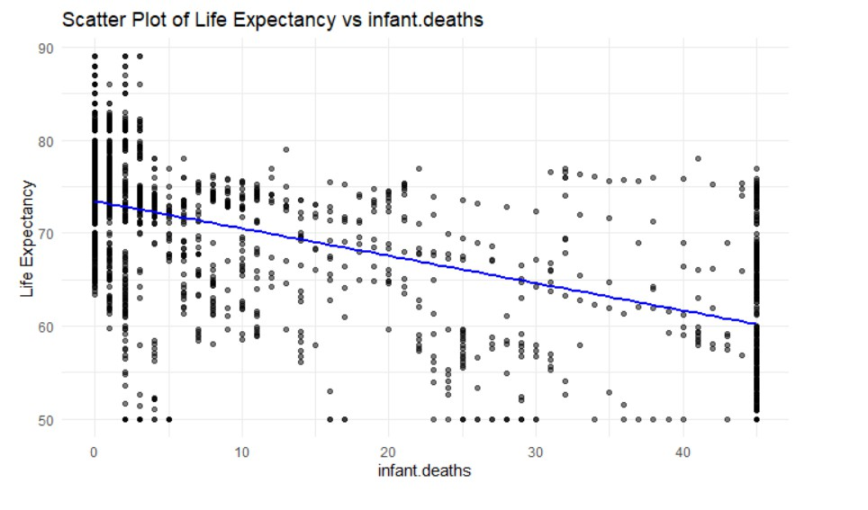
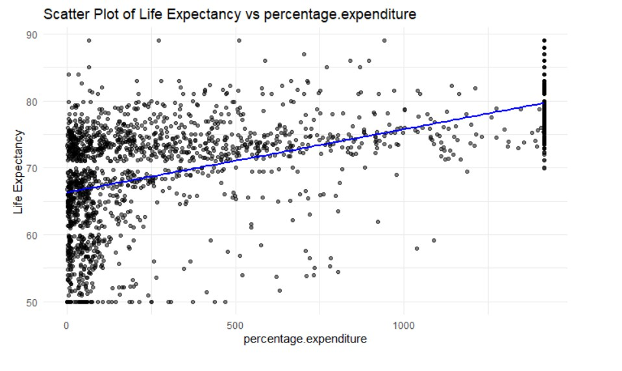
Data Visualization

Slide 18
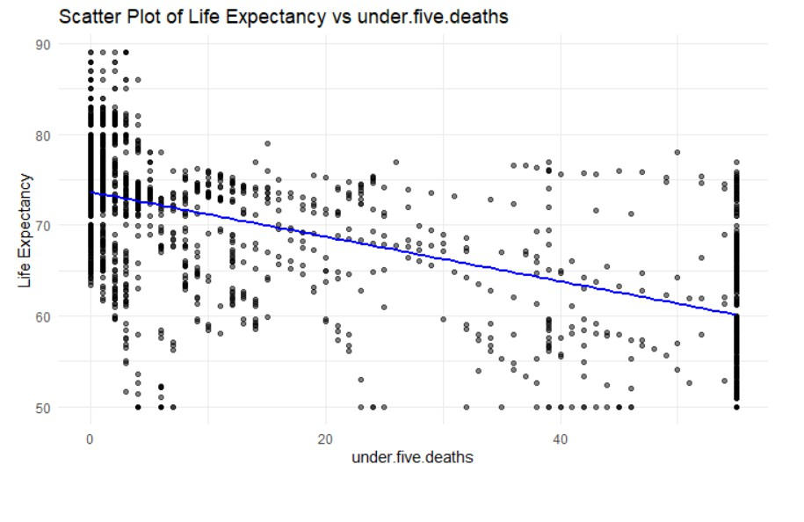
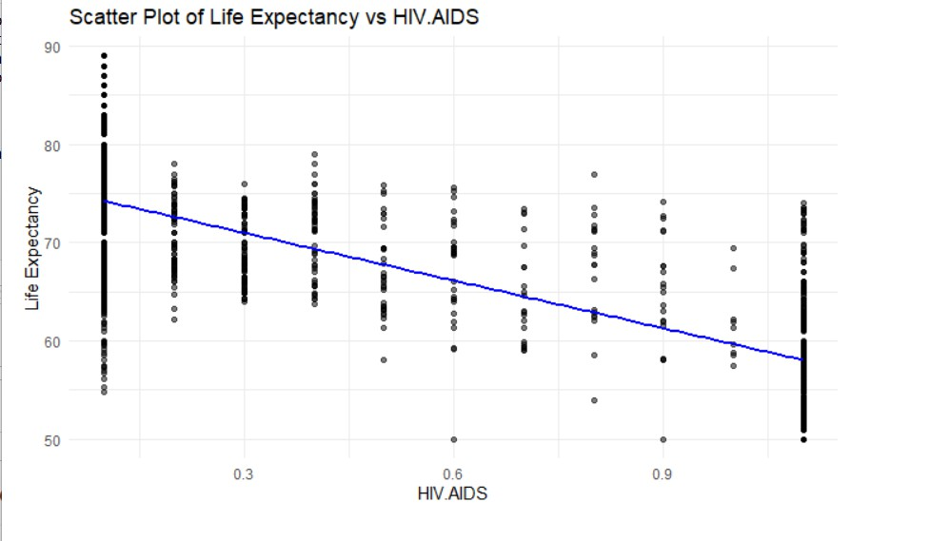
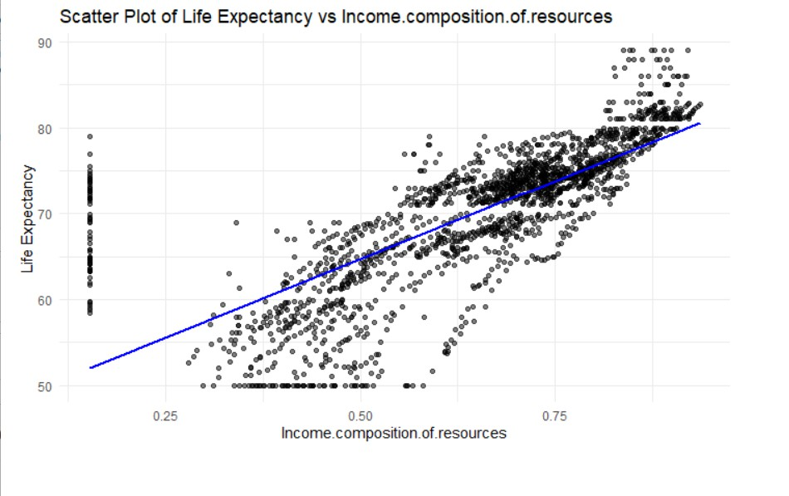
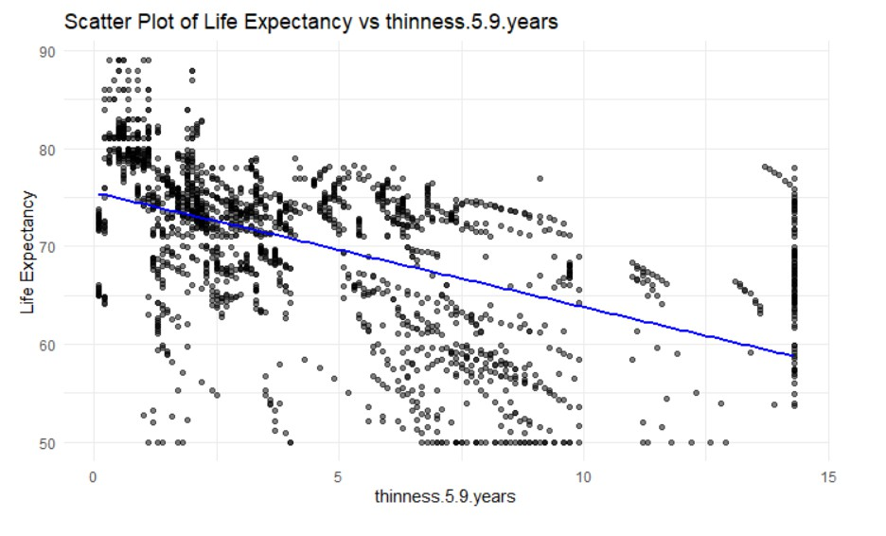
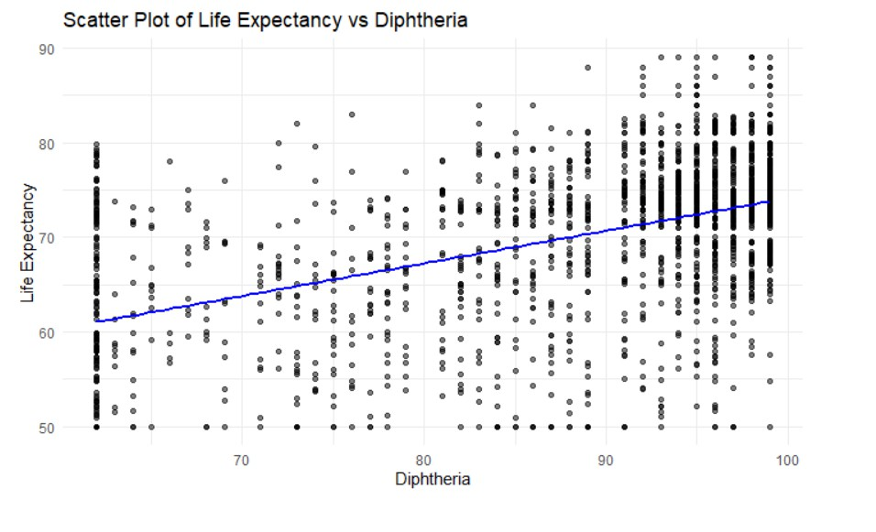
Data Visualization

Slide 19
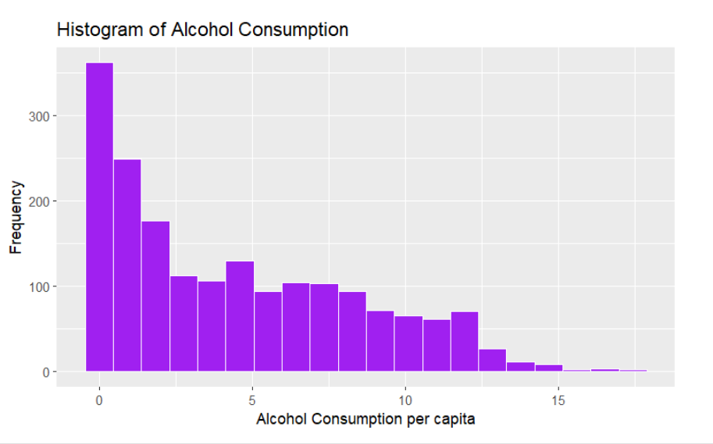
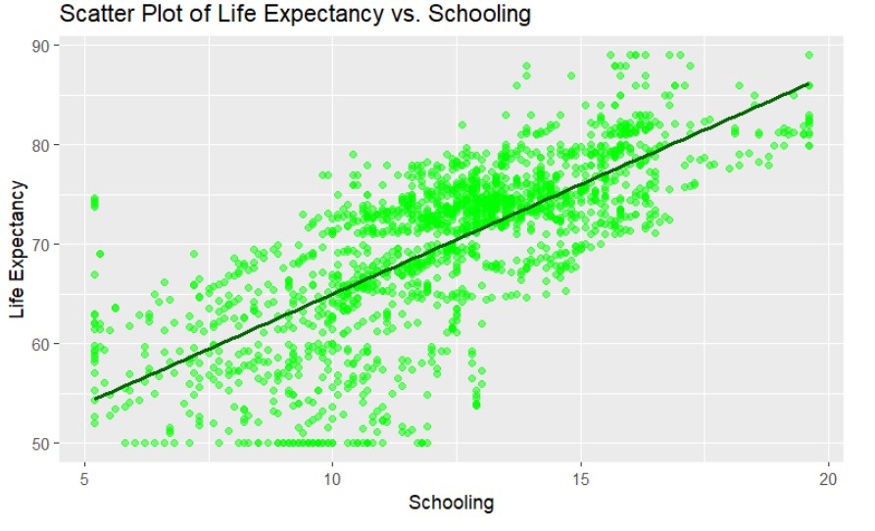
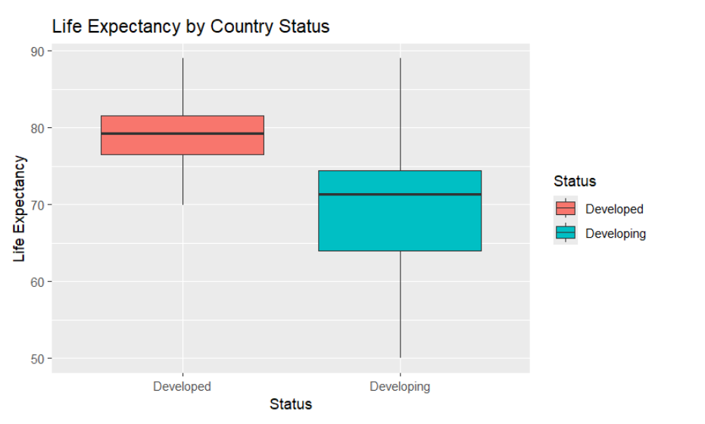
Data Visualization

Slide 20

CONCLUSION
From the statistical analysis it can be concluded that the best model for determining life expectancy is a linear regression model with the status of development, adult mortality, infant deaths, health expenditure as a percentage of GDP, Hepatitis B coverage, under-five deaths, Diphtheria immunization coverage, HIV/AIDS prevalence, income composition of resources, thinness in children aged 5-9 years, and schooling as significant explanatory variables.
For the first research question, small p-values indicate that the observed relationships between these variables and life expectancy are highly unlikely to have occurred by chance, the evidence strongly suggests that these health indicators and socio-economic factors are indeed significant determinants of life expectancy across different countries.
For the second research question, the level of education, represented by the "Schooling" variable, has a significant positive impact on life expectancy, even after controlling for economic status and health indicators. The p-value of 2.87e-05 for the "Schooling" variable indicates strong evidence against the null hypothesis, suggesting that education plays a crucial role in determining life expectancy, beyond the effects of other factors

Slide 21
REFERENCE
Freeman, T., Gesesew, H. A., Bambra, C., Giugliani, E. R. J., Popay, J., Sanders, D., Macinko, J., Musolino, C., & Baum, F. (2020). Why do some countries do
better or worse in life expectancy relative to income? An analysis of Brazil, Ethiopia, and the United States of America. International Journal for Equity in Health, 19(1). https://doi.org/10.1186/s12939-020-01315-z
Rogoz, A. T. M., Sart, G., Bayar, Y., & Gavriletea, M. D. (2022). Impact of economic freedom and educational attainment on life expectancy: evidence from the new EU member states. Frontiers in Public Health, 10. https://doi.org/10.3389/fpubh.2022.907138
Singh, G. K., & Lee, H. (2020). Marked disparities in life expectancy by education, poverty level, occupation, and housing tenure in the United States, 1997- 2014. International Journal of MCH and AIDS, 10(1), 7–18. https://doi.org/10.21106/ijma.402

Slide 22
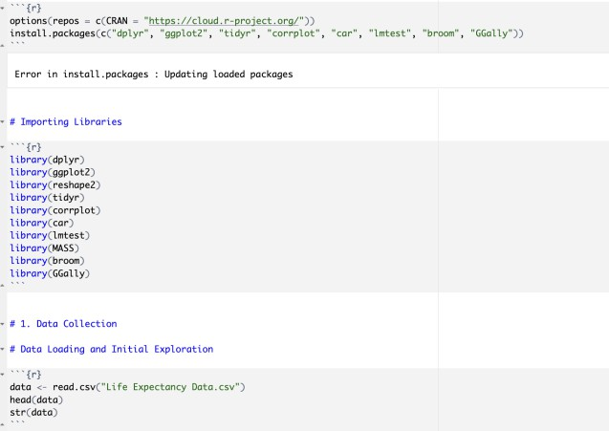
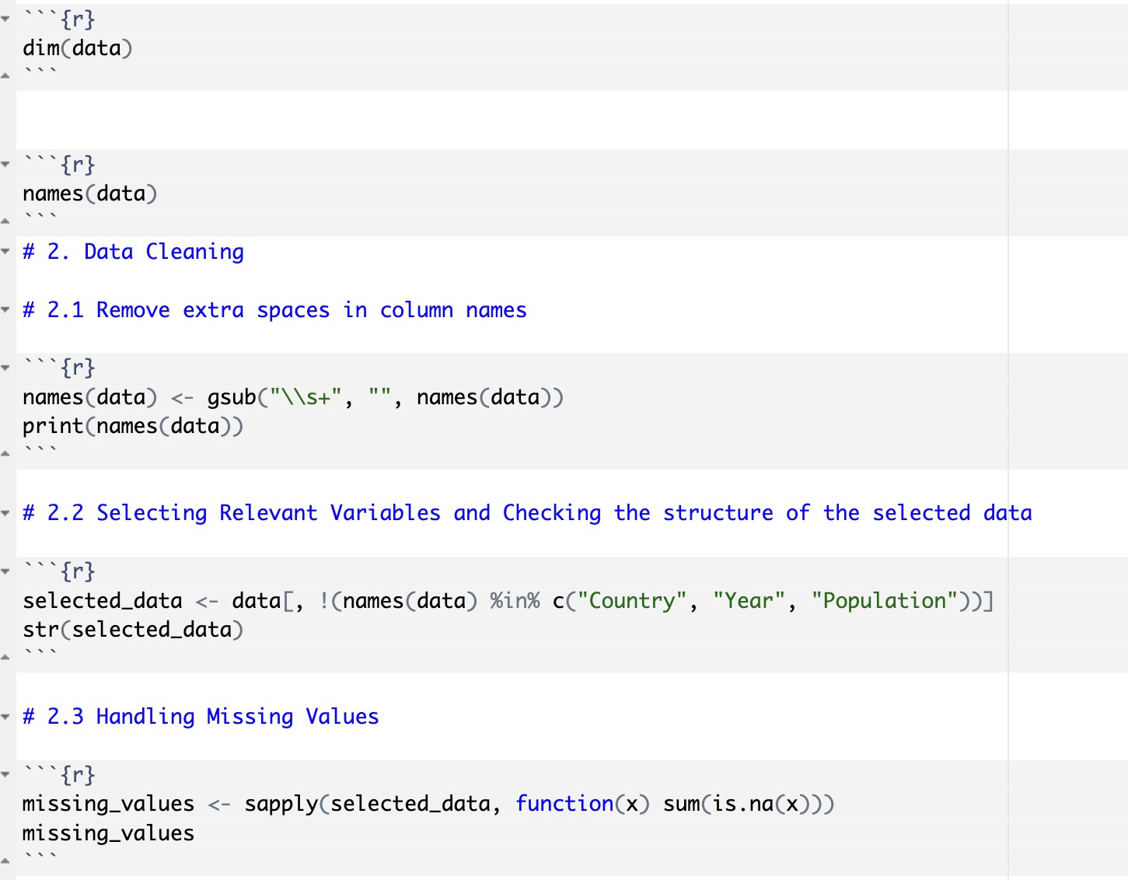
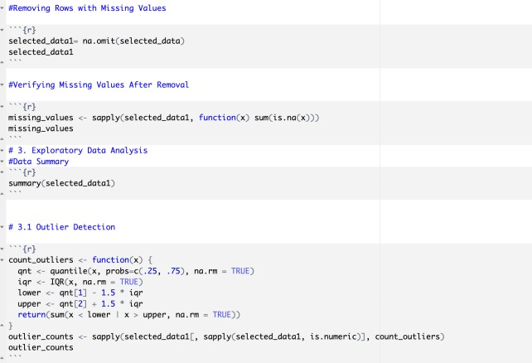
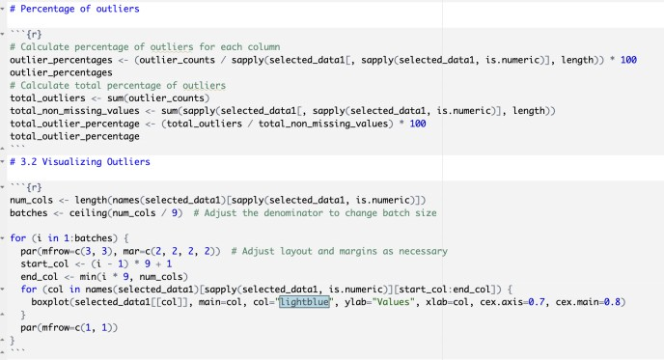
APPENDIX

Slide 23
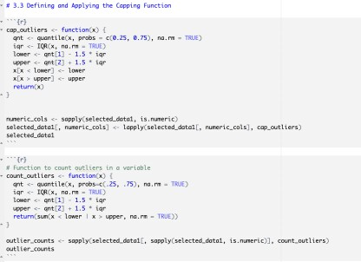
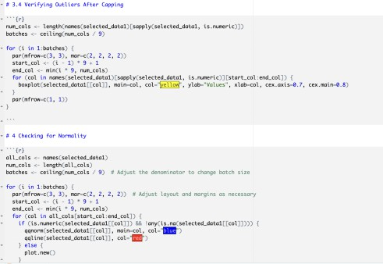
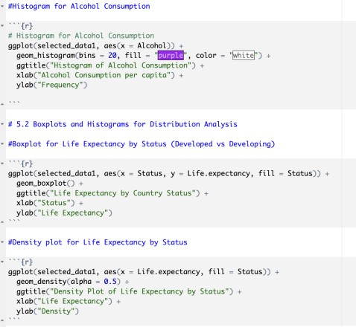
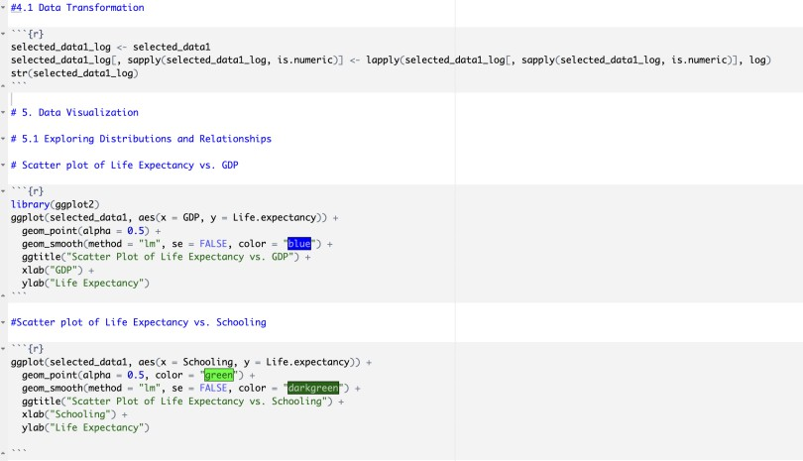
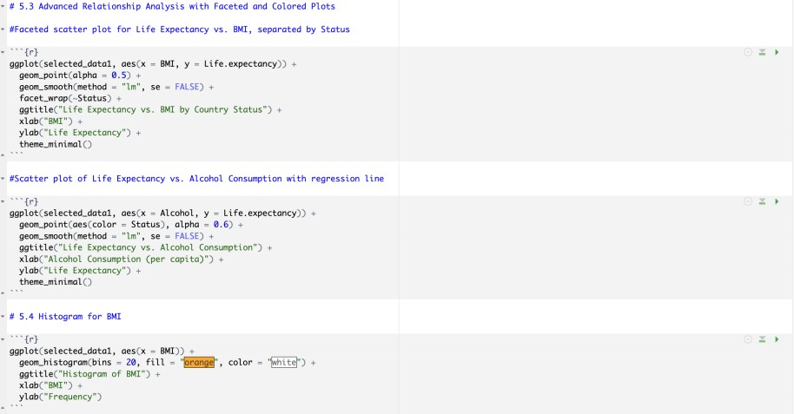
APPENDIX

Slide 24
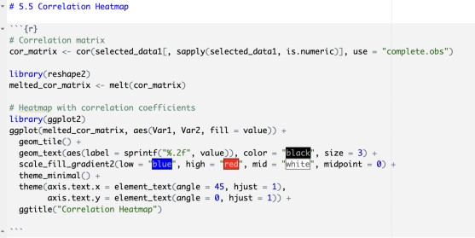
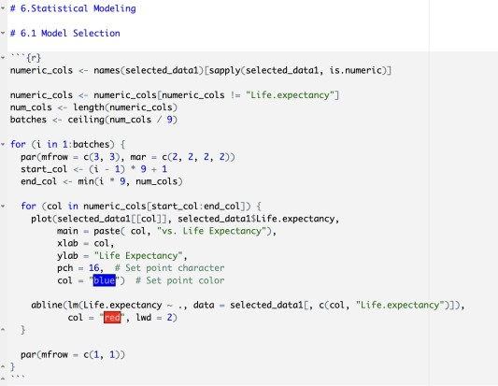
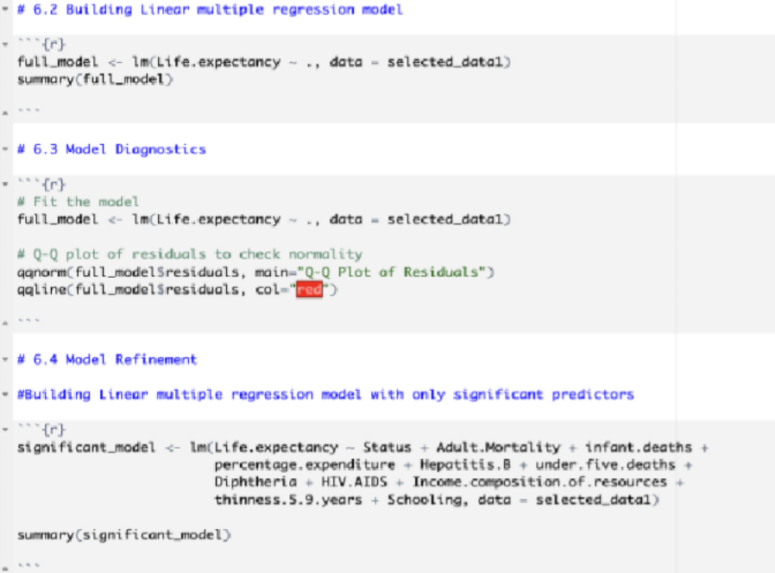
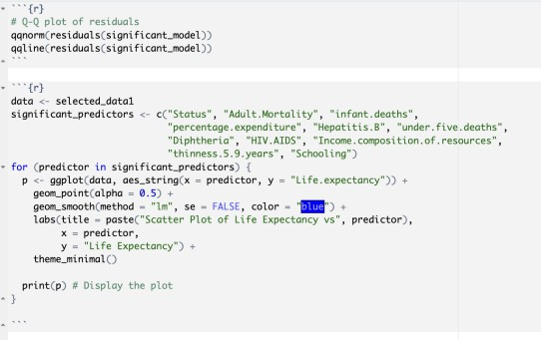
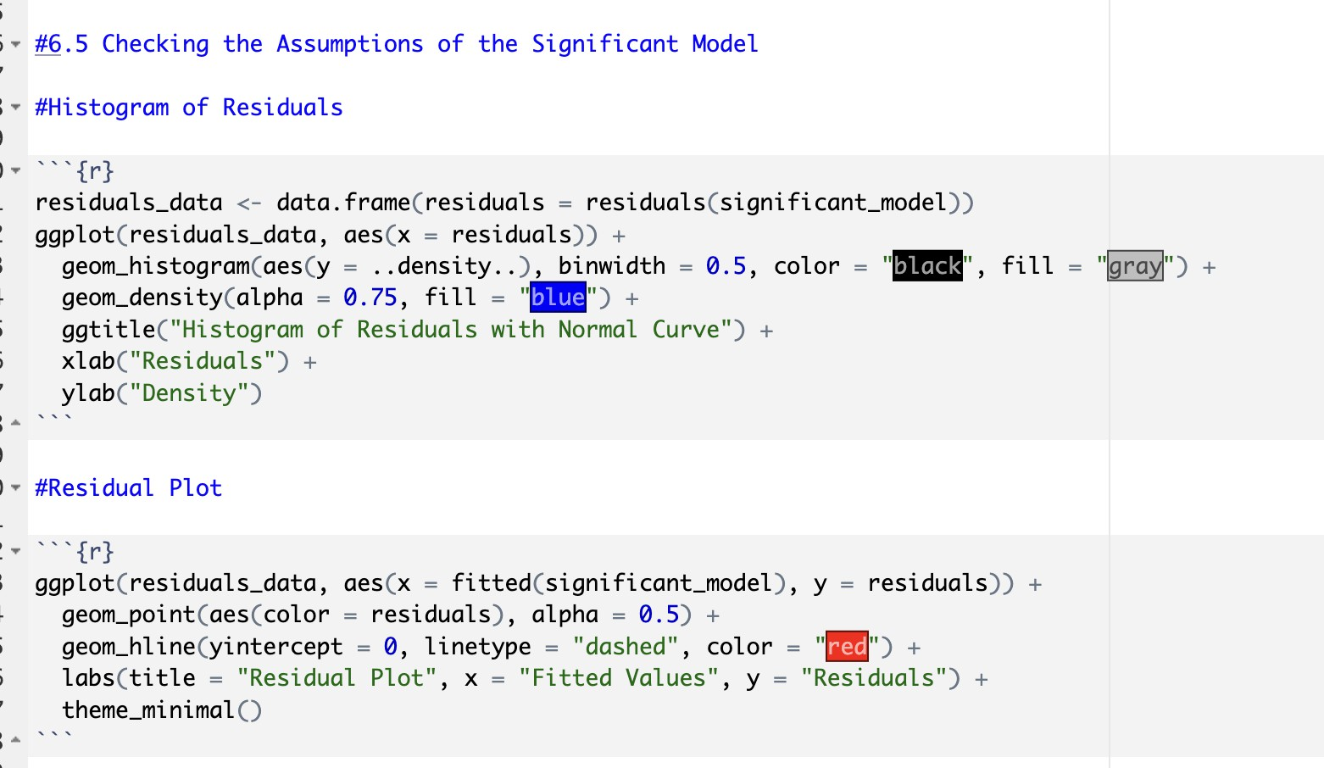
APPENDIX

